Slide 1
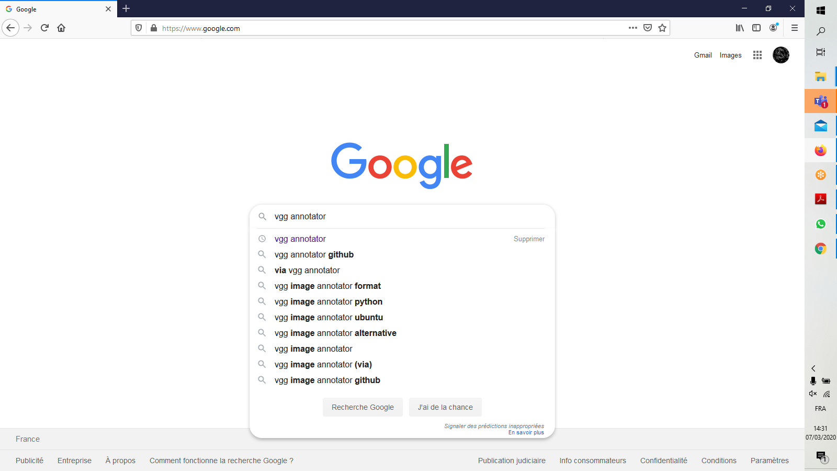
VGG annotator installation

Slide 2
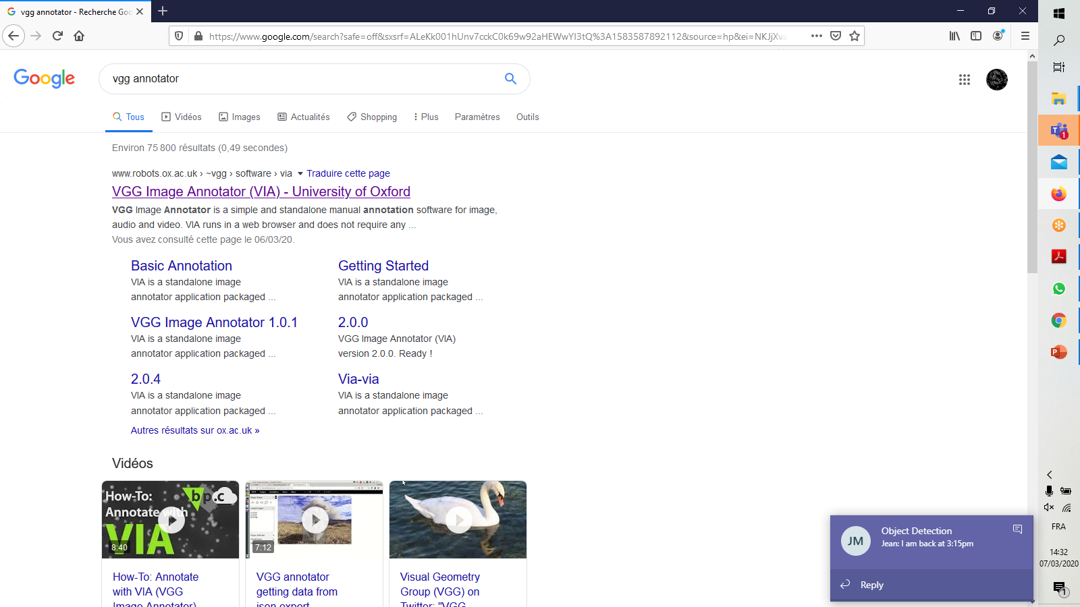
VGG annotator installation

Slide 3
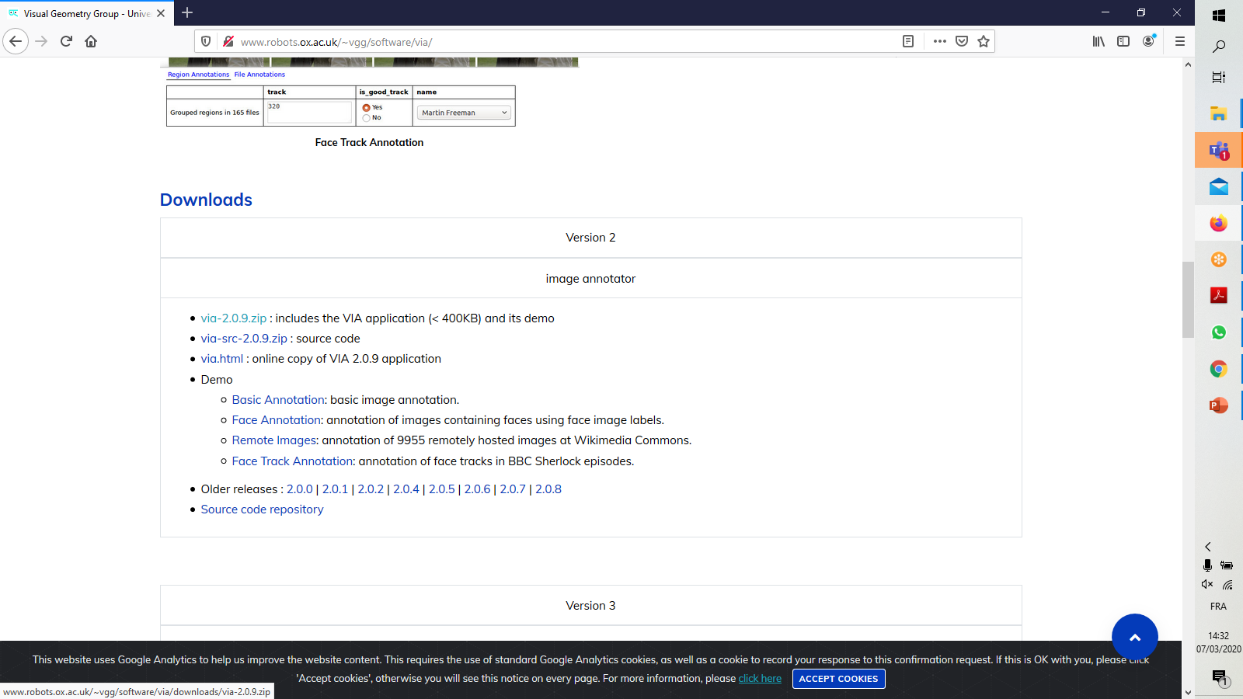
VGG annotator installation

Slide 4
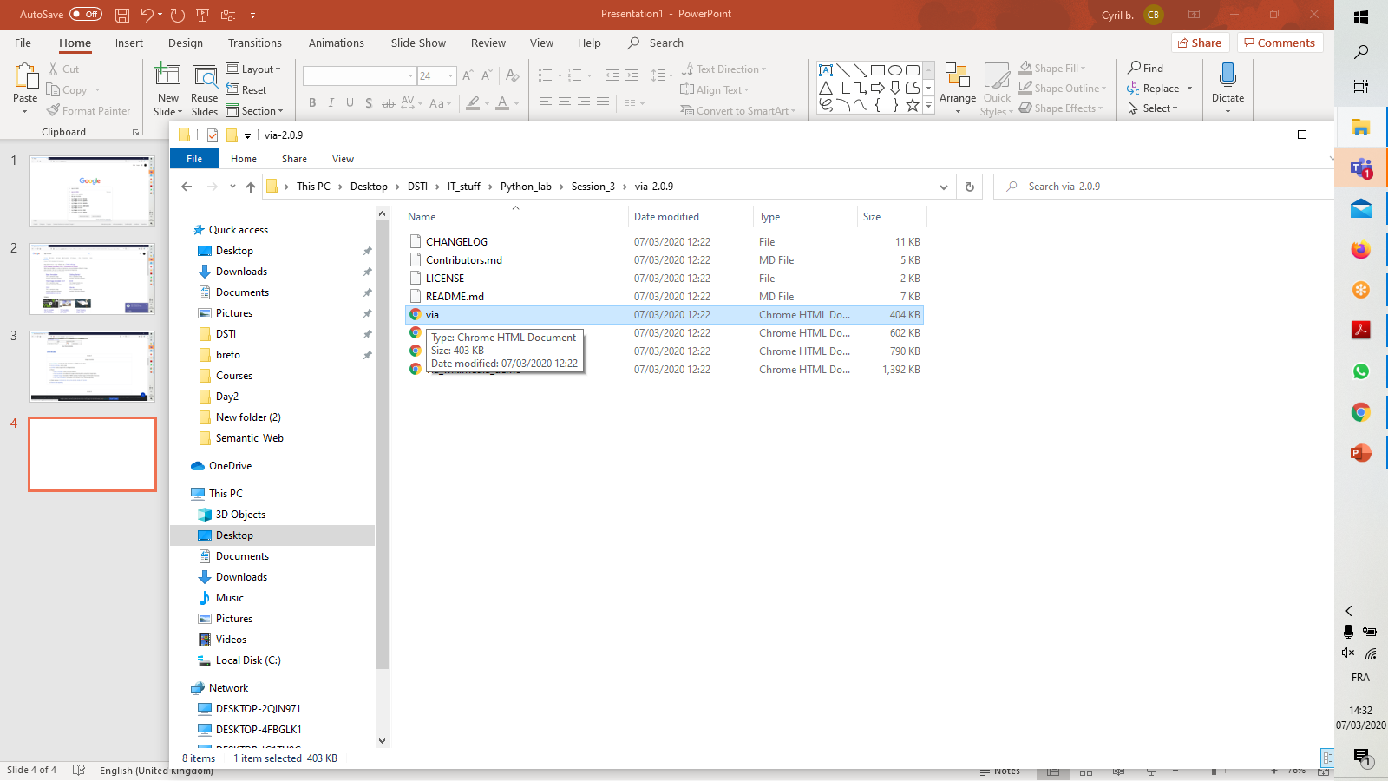
Launch VGG annotator

Slide 5
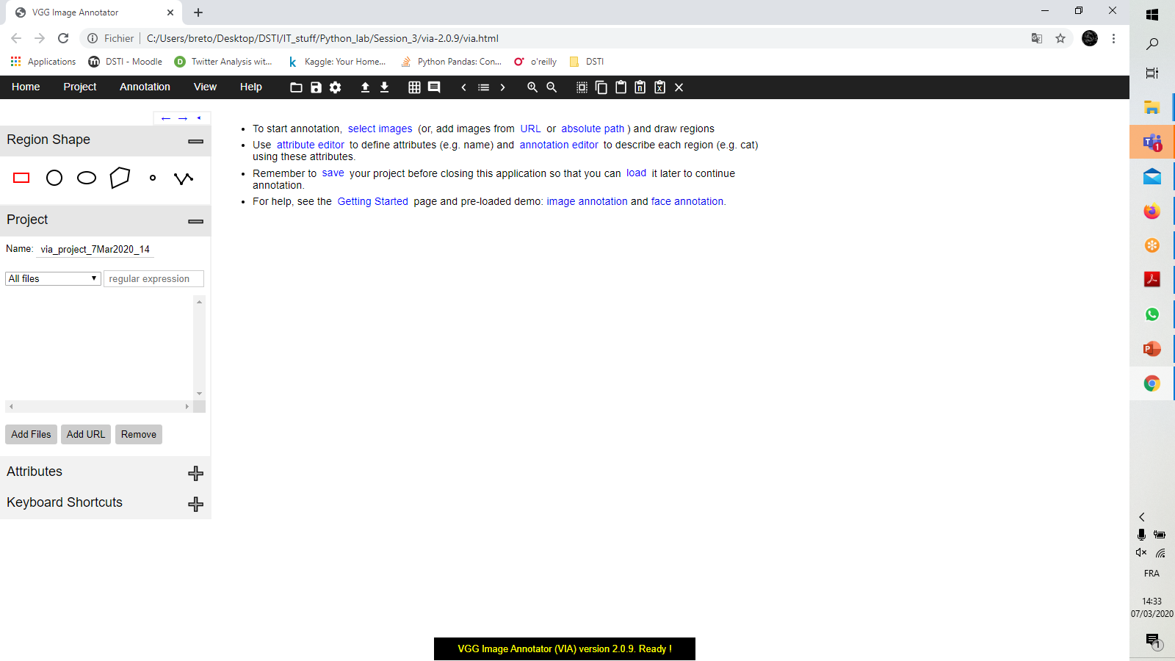
VGG annotator window
Add an attribute named « clothe »

Slide 6
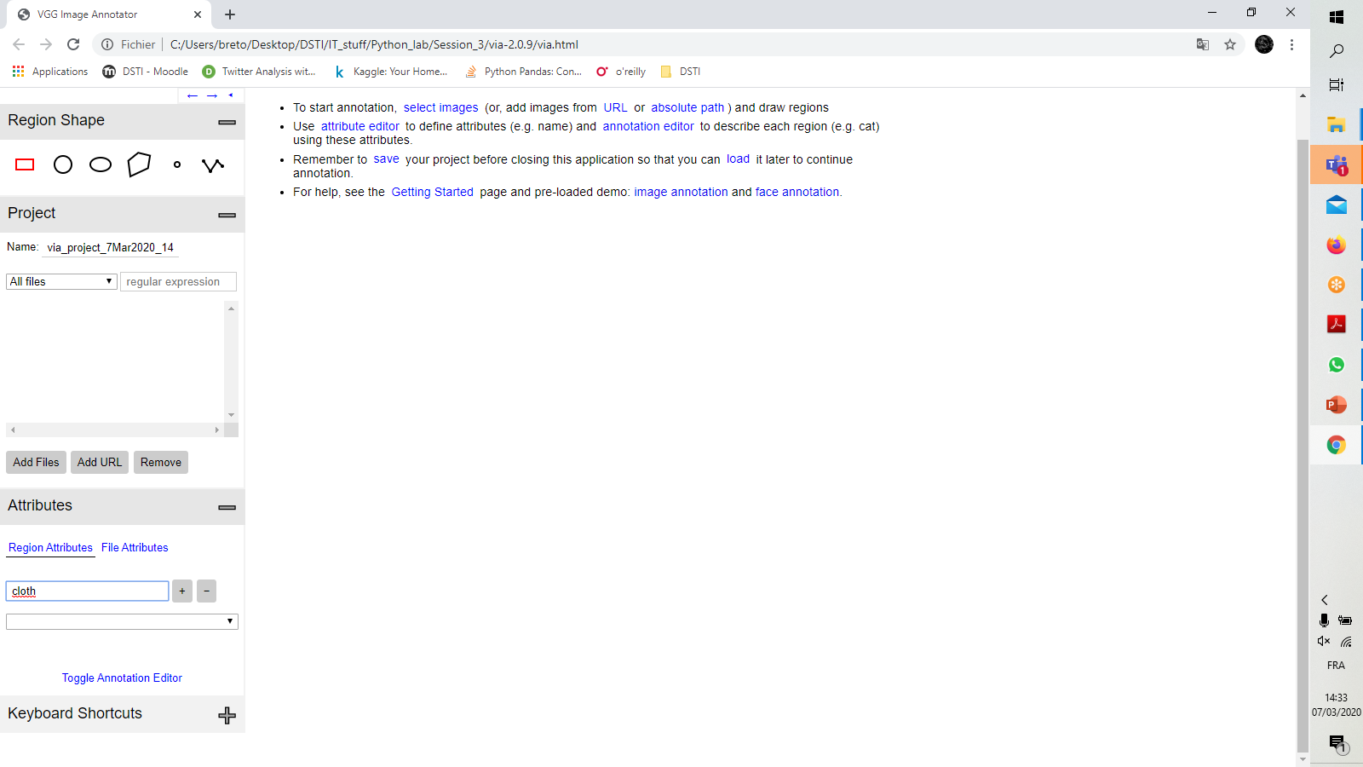
Add an attribute named « clothe »

Slide 7
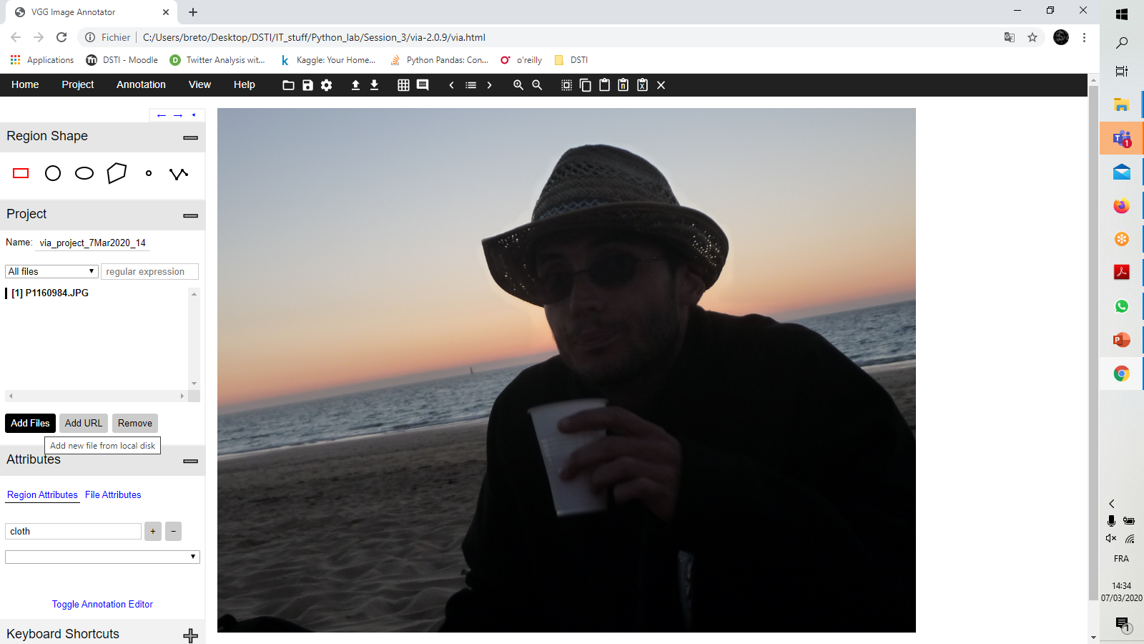
Open the unlabelled image

Slide 8
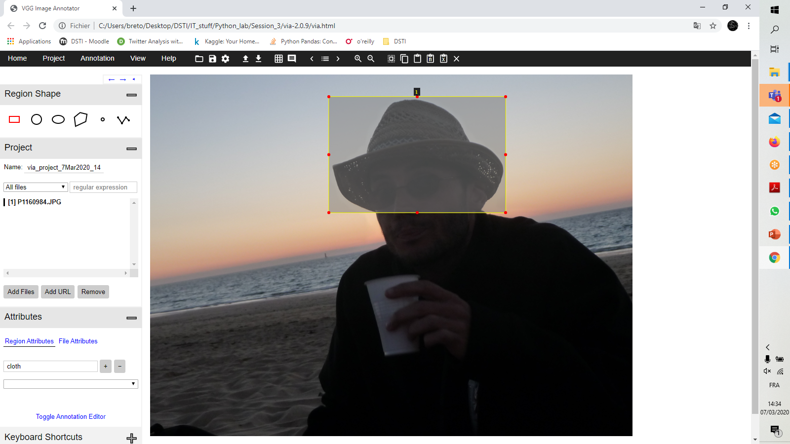
Put a box on the target

Slide 9
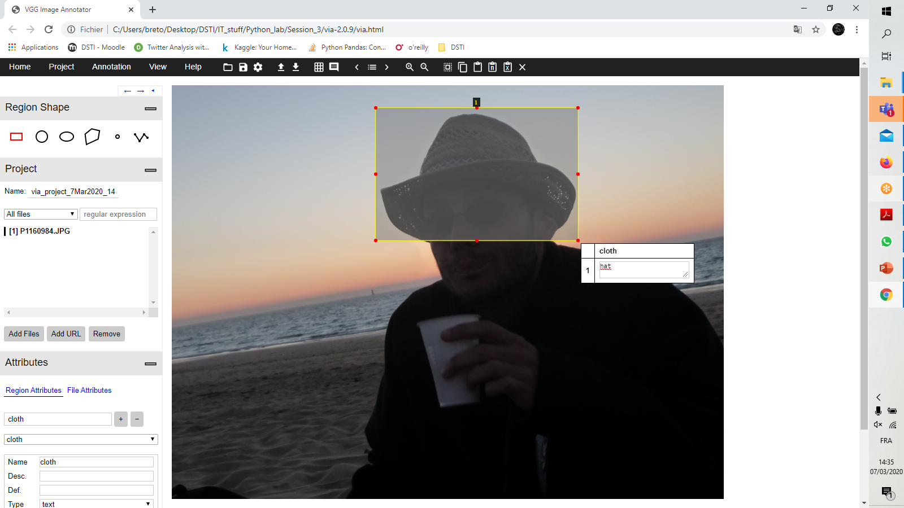
Double click on the box and label it

Slide 10
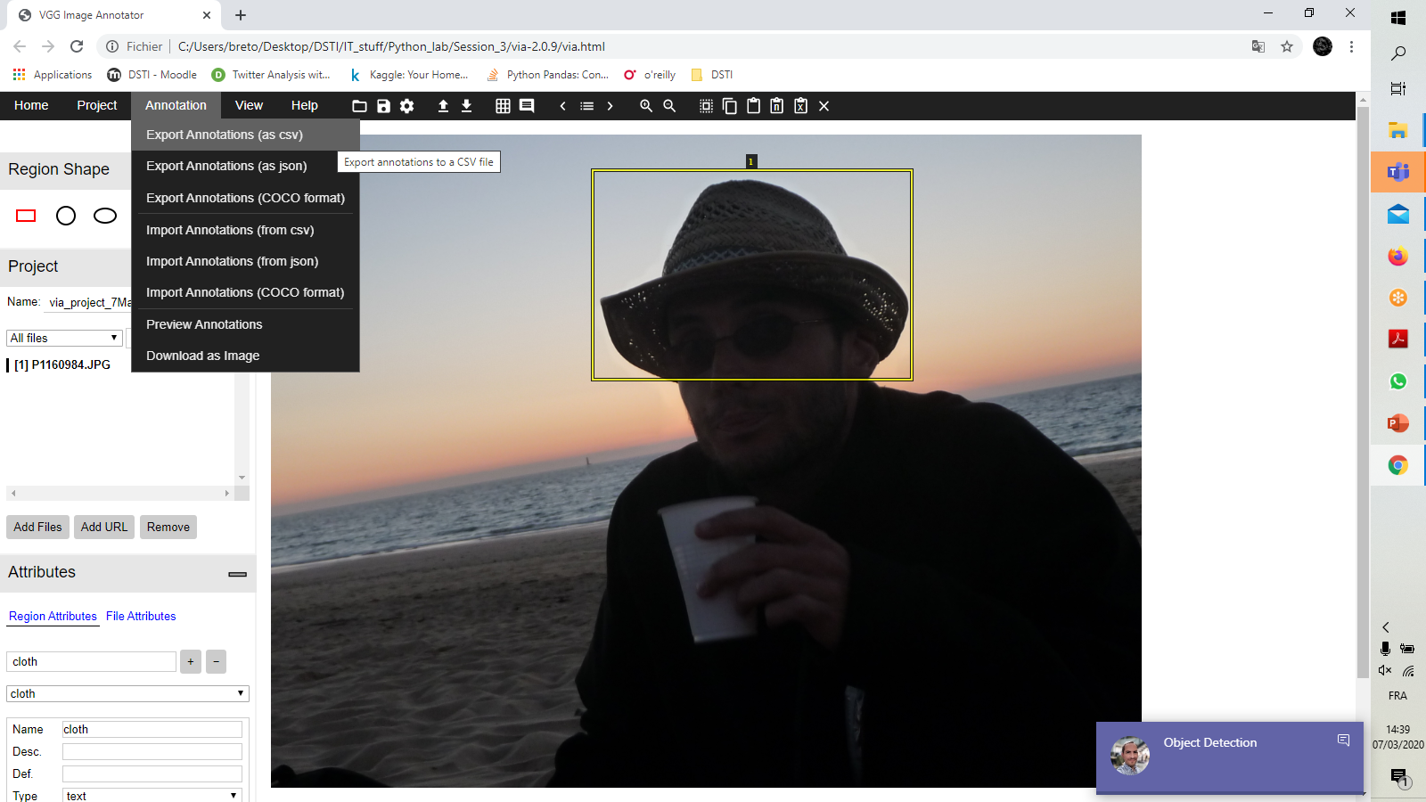
Export the label as csv

Slide 11
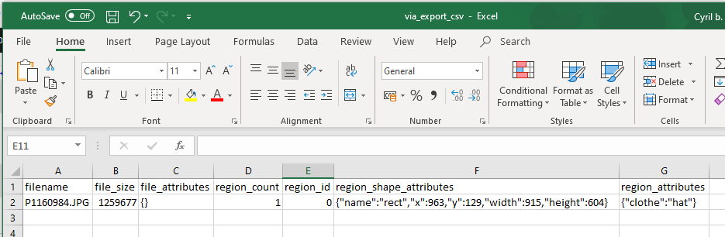
Top left corner coordinates
of the box
Name of the image

